Slide 1
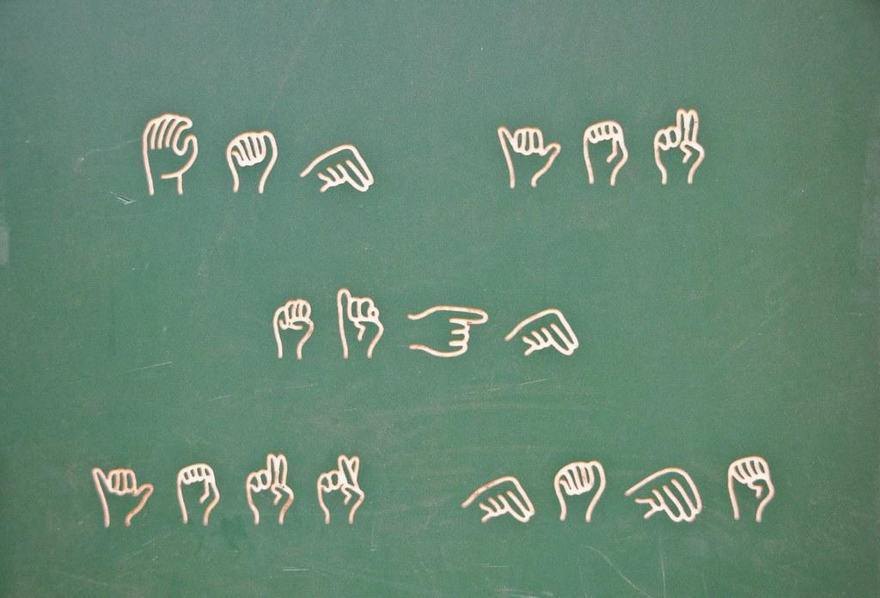


Major Project SRS Submitted to
Rajiv Gandhi Proudyogiki Vishwavidyalaya, Bhopal
Towards Partial Fulfillment for the Award of
Bachelor of Engineering
(Computer Science and Engineering)
Supervised By: Guided by:
Prof. Shivshankar Rajput Ms. Nisha Rathi

Slide 2
Software Requirements Specification Presentation
Sign Language Converter

Slide 3
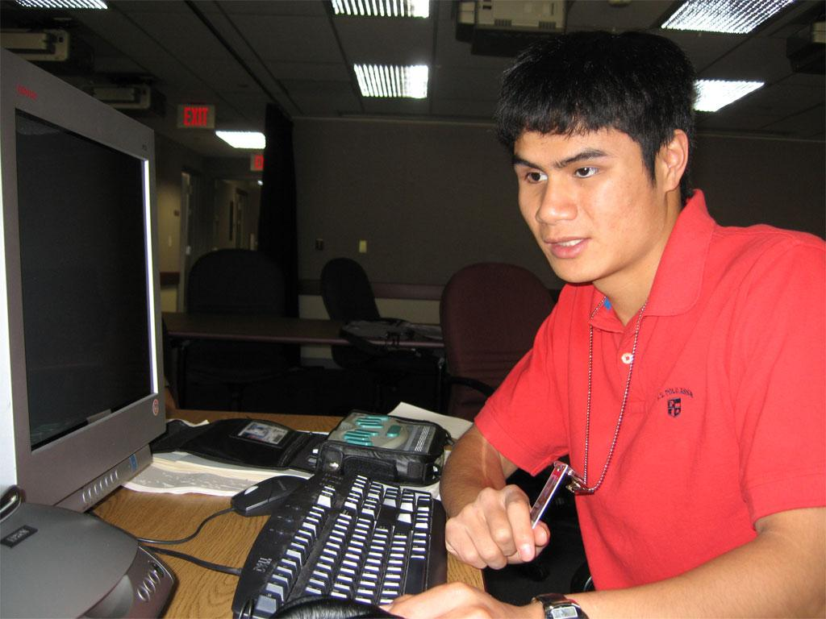
PURPOSE
This project will help a person who has learning disability to communicate with others and vice versa. Thus, eliminating the need of translator between them.

Slide 4

Sign Language Converter is a desktop application which can be used to convert audio to text and then to sign language. The project is a machine learning program that detects and recognizes audio signals received to text using speech to text API (python modules or Google API) and then makes a visual presentation (video) of the converted sign language which requires machine learning as a part.
INTRODUCTION

Slide 5
SCOPE
This can be used to help disabled people.
This can be used by people to understand the sign language and help those people communicate through it.
This can be used on wide scale to make most of the public understand what a person is trying to convey to the world through sign language.
This will prevent the disabled people from hiring other people who can speak and understand sign language just to be their communicator.
This can be implemented with other technologies too like iot, android and thus has a lot of scope

Slide 6
PRODUCT FUNCTION
Audio input on a Personal Digital Assistant(PDA) using python PyAudio module.
Conversion of audio to text
Dependency parser for analysing the grammatical structure of the sentence and establishing relationships between words.
Generation of Sign language

Slide 7
GENERAL CONSTRAINTS
The only disadvantage of the programming language is its speed.
Python is not the fastest programming language still it is versatile and adopted broadly.
Noise in background may cause application to generate error-prone results.

Slide 8
Functional Requirements
Sign Language Converter

Slide 9
Operating System: Windows XP/ Windows 7/ Linux
RAM: 2 GB recommended
Hardware Devices: Webcam enabled system
Display: Standard Output Display
Audio: Microphone (preferred)
Hardware Requirements

Slide 10
Technology Implemented: Machine Learning, Artificial Intelligence, Natural Language Processing
Language Used: Python
User Interface Design: Desktop Application
Model: Spiral Model
Software Requirements

Slide 11
Non Functional Requirements
Sign Language Converter

Slide 12
The Audio to Sign Language Converter is based on python. The program shall take initial load time. The performance shall also depend upon hardware components of the client.
PERFORMANCE

Slide 13
Python is very reliable. The language has been around for over 20 years, and is in use in many sites. Python is actively maintained, so when problems are reported, they are dealt with promptly. But of course it is a programming language, which means the reliability of code you write depends on your skill at programming. If you write buggy code. Python cannot save you from your own errors.
RELIABILITY

Slide 14
Python is a very secured programming language. Thus, the application made is highly secured.
SECURITY

Slide 15
The product is highly portable as it can be accessed from any device with any operating system.
PORTABILITY

Slide 16
The product has high fault tolerance. Thus, maximizing its efficiency.
FAULT TOLERANCE

Slide 17
Implementation of Project
Implementation of the Project
Sign Language Converter

Slide 18
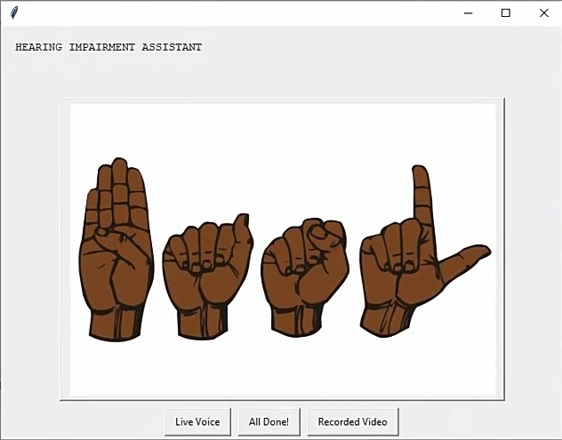
Main Window

Slide 19
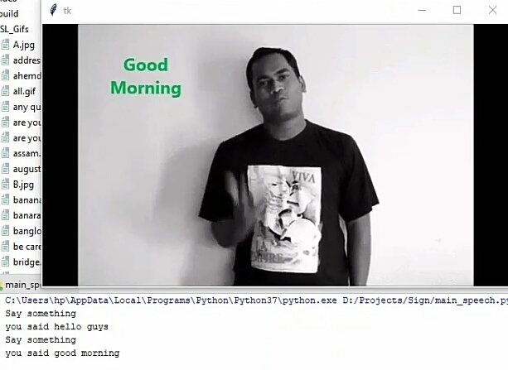
Audio to Sign Language

Slide 20
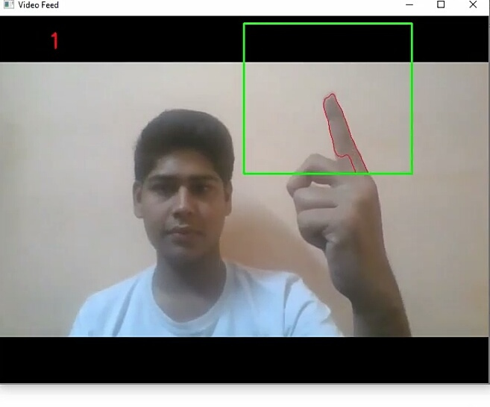
Sign Language to Text

Slide 21
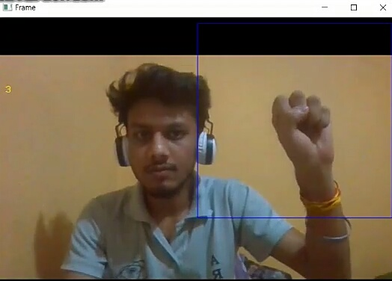

Slide 22
SDLC MODEL used
Sign Language Converter

Slide 23
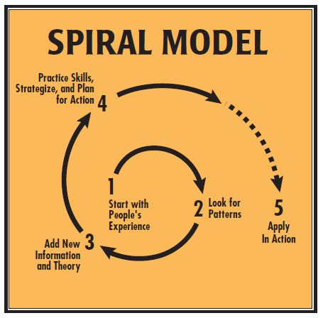

Slide 24
Additional functionality or changes can be done at a later stage
Cost estimation becomes easy as the prototype building is done in small fragments
Continuous or repeated development helps in risk management
Development is fast and features are added in a systematic way
There is always a space for customer feedback
WHY SPIRAL MODEL ???

Slide 25

THANK YOU!

